Slide 1
Command Line Arguments & Storage Classes in C

Slide 2
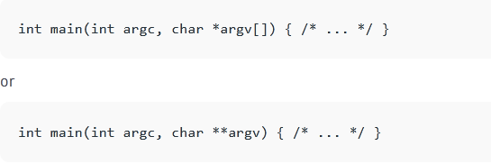
Command Line Arguments
It is possible to pass some values from the command line to your C programs when they are executed
int main() { /* ... */ } replaced by

Slide 3
argc (ARGument Count) is int and stores number of command-line arguments passed by the user including the name of the program. So if we pass a value to a program, value of argc would be 2 (one for argument and one for program name). The value of argc should be non negative.
argv(ARGument Vector) is array of character pointers listing all the arguments. If argc is greater than zero, the array elements from argv[0] to argv[argc-1] will contain pointers to strings.
Argv[0] is the name of the program , After that till argv[argc-1] every element is command -line arguments.

Slide 4
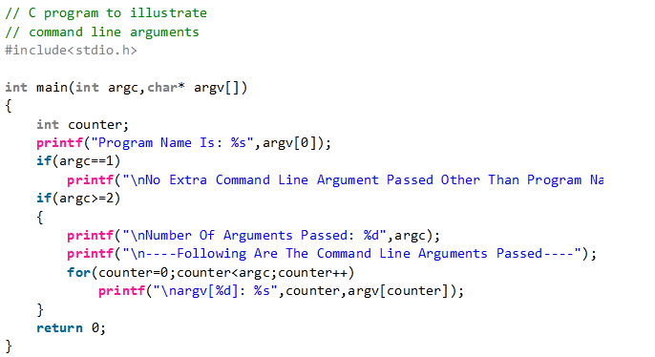

Slide 5
Storage Classes
used to describe the features of a variable/function. These features basically include the scope, visibility and life-time which help us to trace the existence of a particular variable during the runtime of a program.

Slide 6
A storage class in C is used to describe the following things:
The variable scope.
The location where the variable will be stored.
The initialized value of a variable.
A lifetime of a variable.
Who can access a variable?

Slide 7
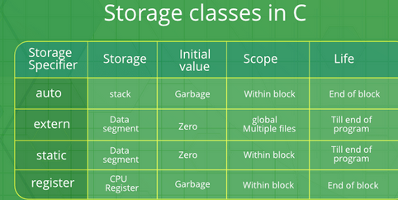

Slide 8
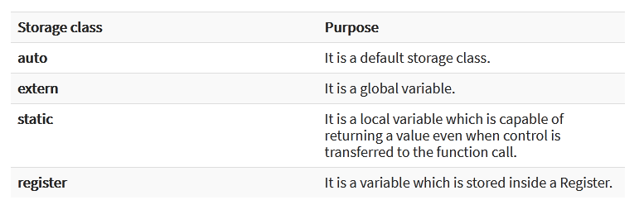

Slide 9
Auto Storage Class
The scope of an auto variable is limited with the particular block only. Once the control goes out of the block, the access is destroyed. This means only the block in which the auto variable is declared can access it.
A keyword auto is used to define an auto storage class. By default, an auto variable contains a garbage value.

Slide 10
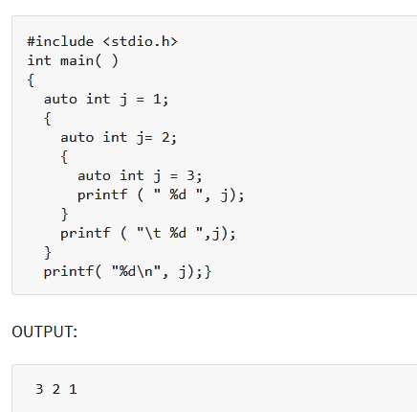

Slide 11
Extern Storage Class
Extern stands for external storage class. Extern storage class is used when we have global functions or variables which are shared between two or more files.
The variables defined using an extern keyword are called as global variables. These variables are accessible throughout the program.

Slide 12
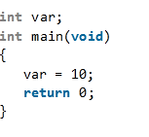
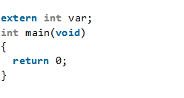
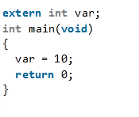
This program compiles successfully. var is defined (and declared implicitly) globally.
This program compiles successfully. Here var is declared only. Notice var is never used so no problems arise.
This program throws an error in the compilation because var is declared but not defined anywhere. Essentially, the var isn’t allocated any memory. And the program is trying to change the value to 10 of a variable that doesn’t exist at all.

Slide 13
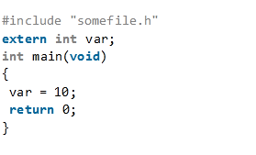
Assuming that somefile.h contains the definition of var, this program will compile successfully.
#include <stdio.h>
int var=20;
named as somefile.h

Slide 14
Points to recap:the extern keyword
A declaration can be done any number of times but definition only once.
the extern keyword is used to extend the visibility of variables/functions.
Since functions are visible throughout the program by default, the use of extern is not needed in function declarations or definitions. Its use is implicit.
When extern is used with a variable, it’s only declared, not defined.
As an exception, when an extern variable is declared with initialization, it is taken as the definition of the variable as well.

Slide 15
Static Storage Class
The static variables are used within function/ file as local static variables. They can also be used as a global variable.
Static local variable is a local variable that retains and stores its value between function calls or block and remains visible only to the function or block in which it is defined.
Static global variables are global variables visible only to the file in which it is declared.
Keep in mind that static variable has a default initial value zero and is initialized only once in its lifetime.

Slide 16
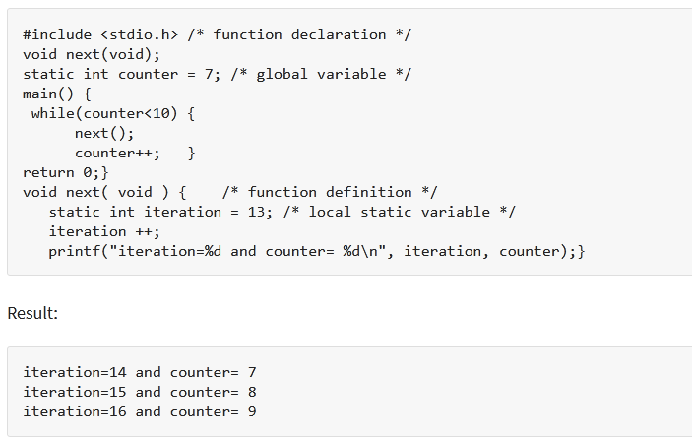

Slide 17
Register Storage Class
to store local variables within functions or blocks in CPU registers instead of RAM to have quick access to these variables.
The variables declared using register storage class has lifespan throughout the program.
The variables declared using register storage class has no default value. These variables are often declared at the beginning of a program.

Slide 18
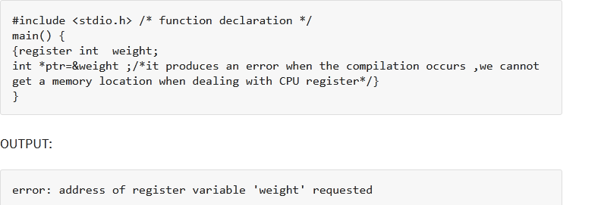

Slide 19
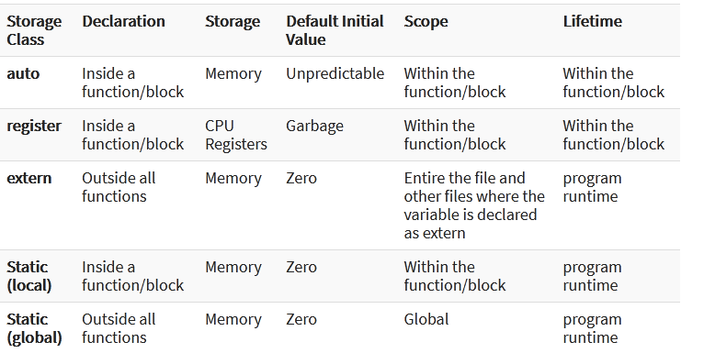
Summary

